Slide 1
Muon FLUX measurement UNDERGROUND with the EEE COSMIC BOX
G.Serri
Università degli studi di Cagliari

Slide 2
Why measurement underground
Natural extension of altitude measurement
Well known sites
Abundance of data of underground measurement
Real and handy example of attenuation phenomena

Slide 3
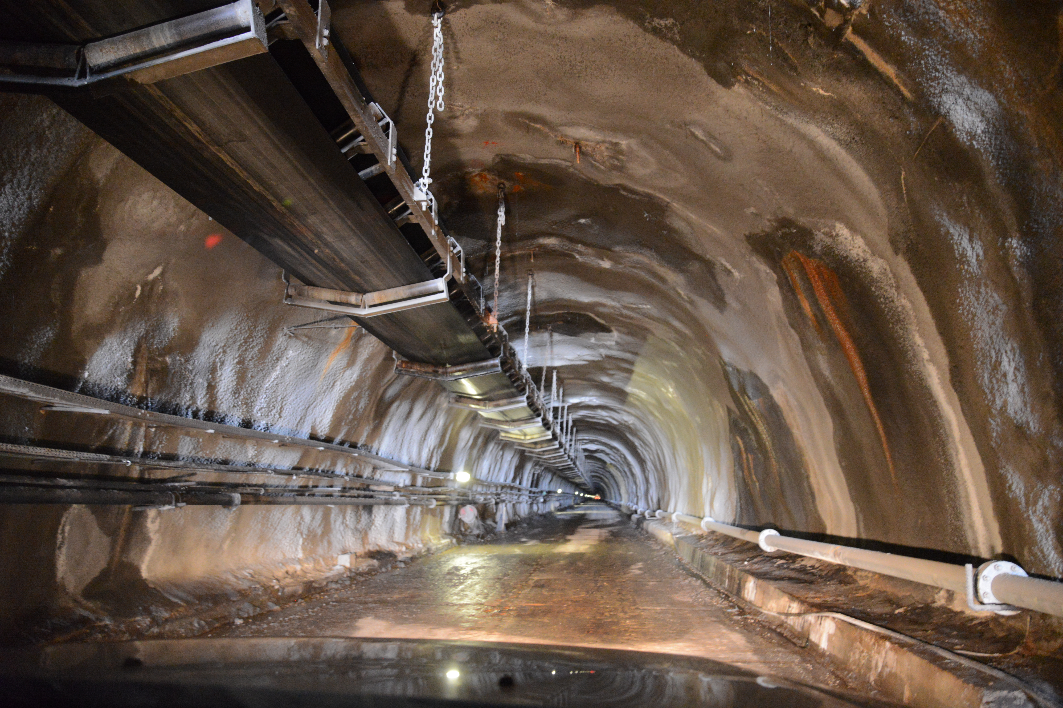
The Nuraxi Figus - Seruci Mine Complex
Why here?
Active mine, no more extractions
Winze
Electric current steady supply
Staff availability : project ARIA
Well studied and safe enviroment

Slide 4
The Detectors
Cosmic Box
Box of two 15x15 cm^2 plastic scintillators (spread 12cm)
Three detectors connected with Raspberry PC
Each event on a CB time tagged
Possibility to add the statistics of the three detectors
Arduino start signal
ASTRO
8 scintillators with single SiPM (4 long 60x8 cm, 4 short 15x8 cm)
Several coincidence combination (2 scintillator or more)
FPGA system control
Hardware temperature correction
Photo-electron Calibration
Transportable in sealed box
Weather station and GPS
20 h autonomy with battery and switch in case of no normal power

Slide 5
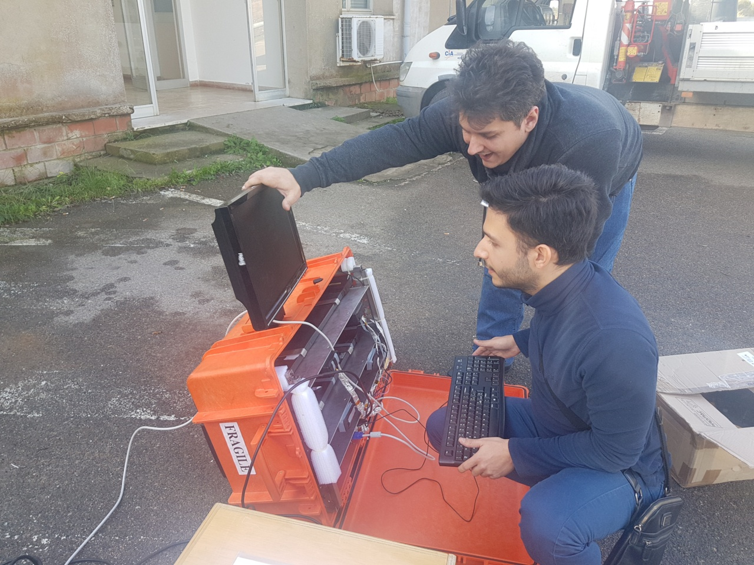
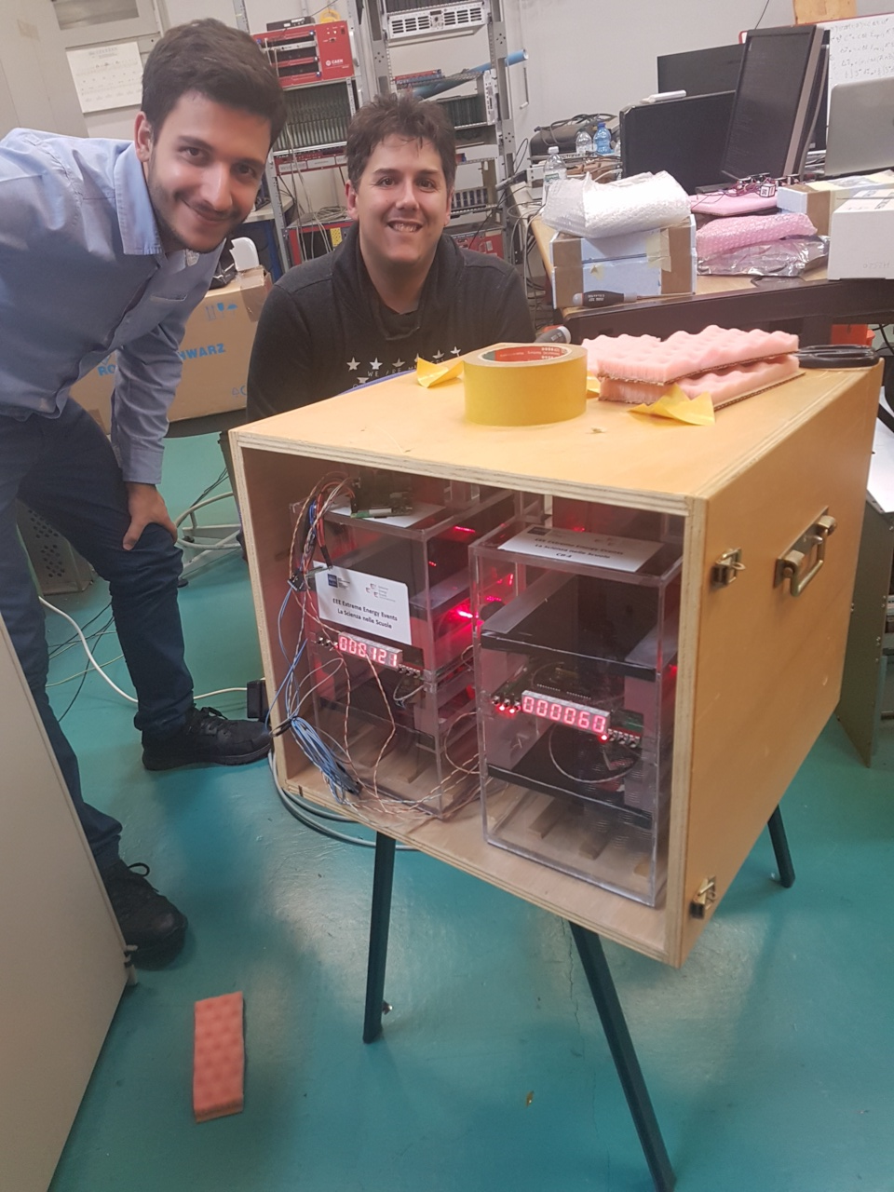

Slide 6
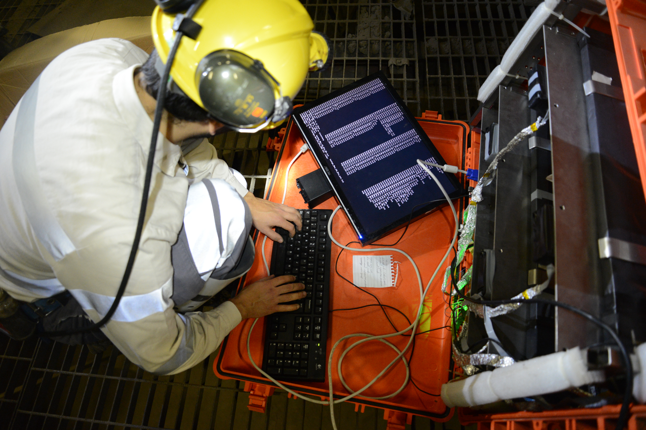
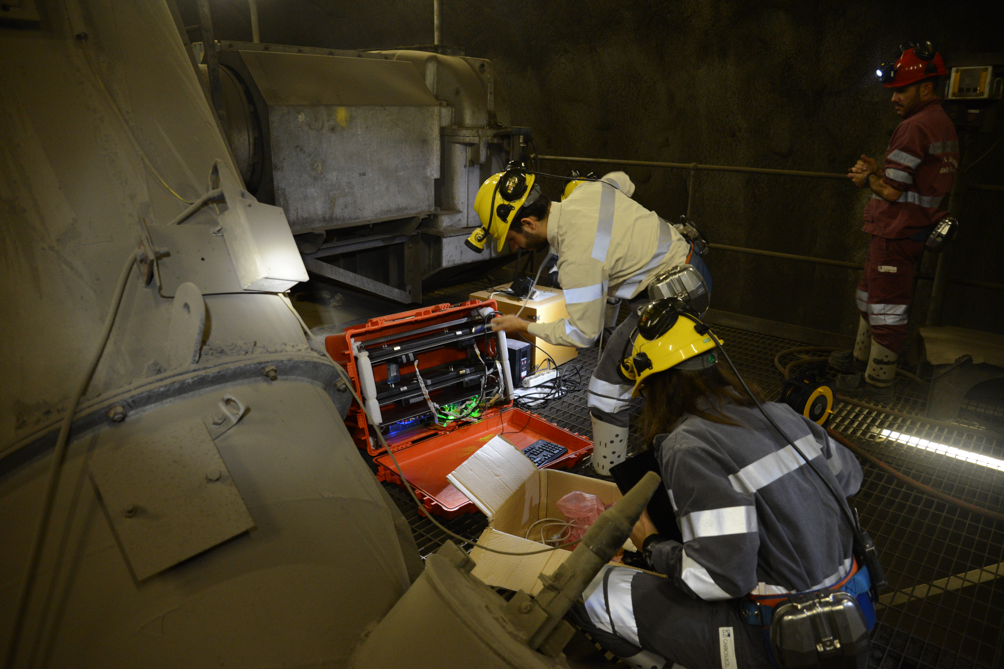
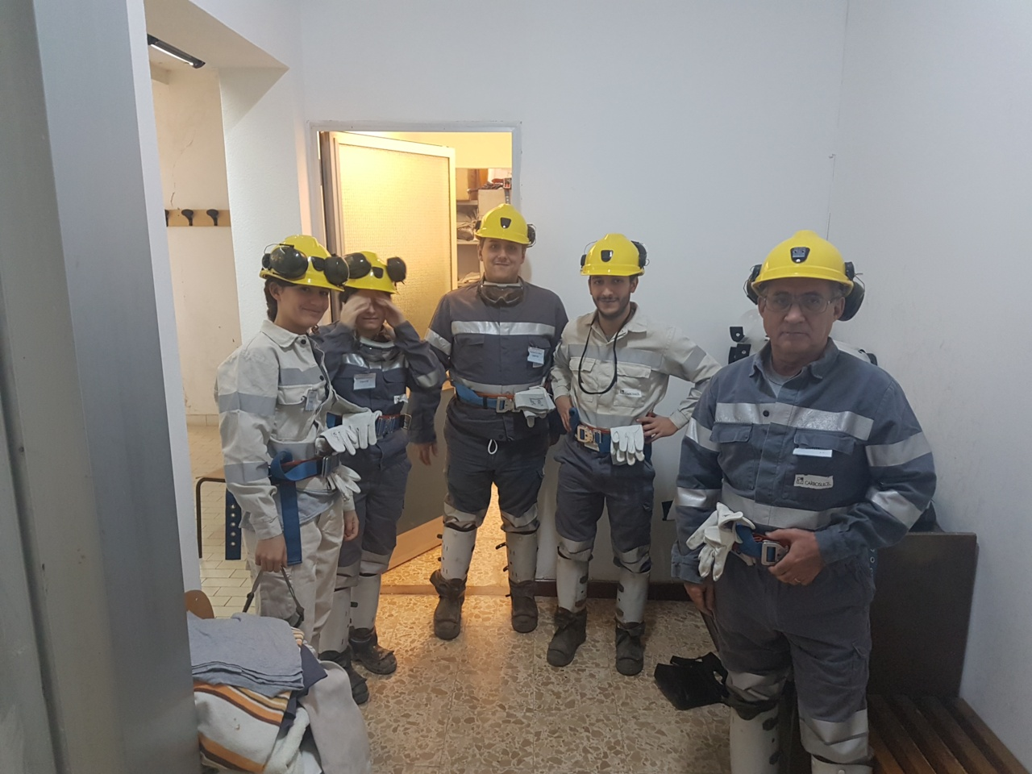
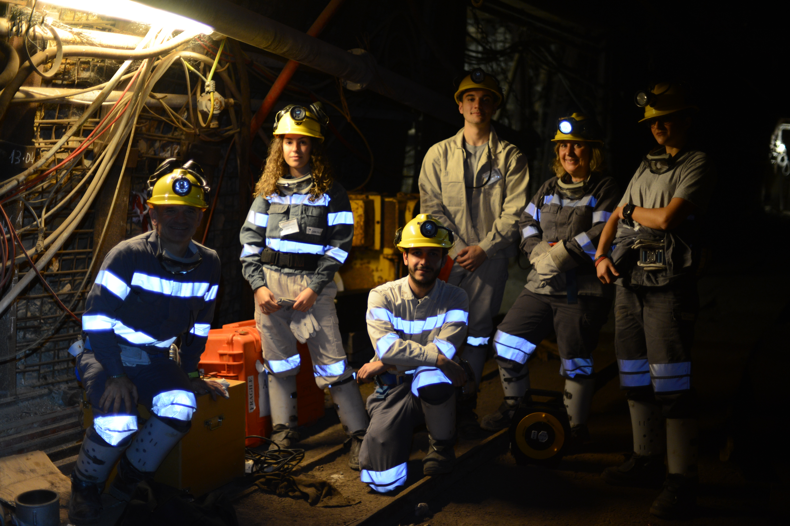
Underground measurement

Slide 7
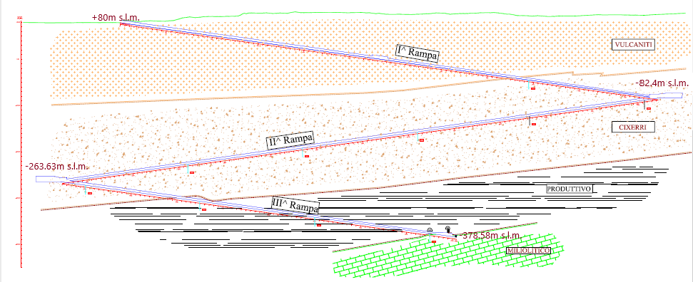
The Measurements
We selected three depths:
Surface (+100 m above sea level A.S.L.) out of the mine entrance
- 174 m (-78 m A.S.L.)
- 339 m (-259 m A.S.L.)
- 500m (-397 m A.S.L.)

Slide 8
developing an experiment: time eStimation
Domusnovas measurement
Comparison and projection of existing models
How much time does the measurement require?

Slide 9
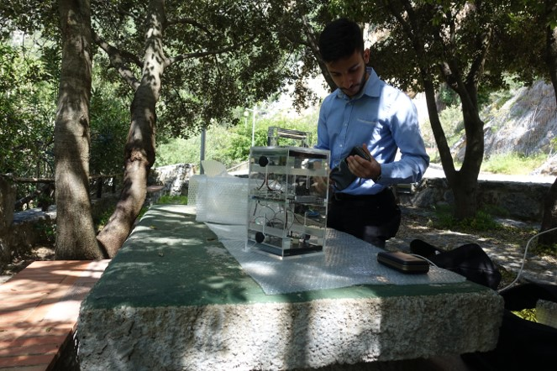
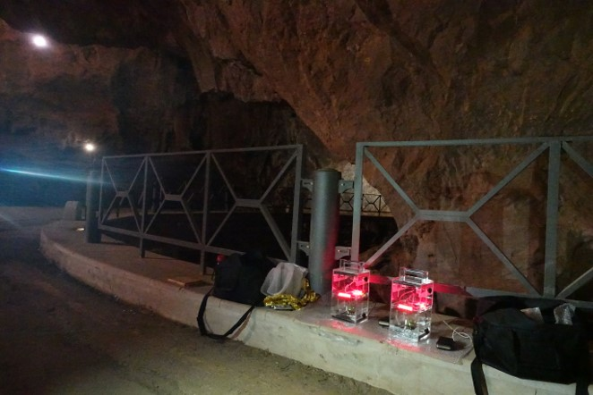
Previous measurement Stefano Boi, Alice Mulliri, Corrado Cicalo’
S.Giovanni cave --> Domusnovas (40 km west of Cagliari). APR 2018
Two Cosmic Box
Outside the cave: R=1.38Hz
Inside the cave(100 m of limestone d≈2.1g/cm³): R=3.9e-3

Slide 10
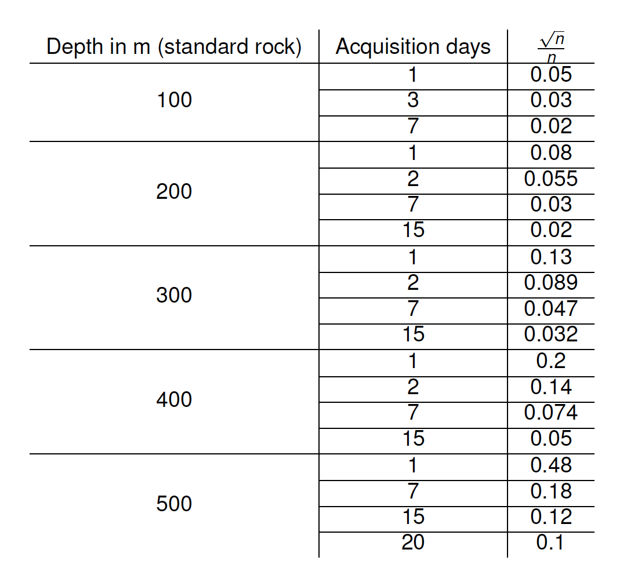
Previous projections in Domusnovas

Slide 11
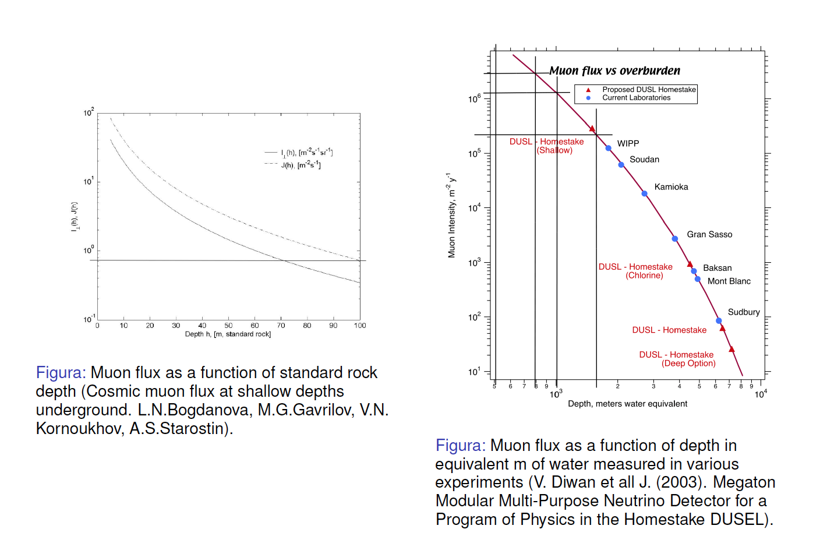
Comparison on Expected Rate

Slide 12
First results of ongoing measurements

Slide 13
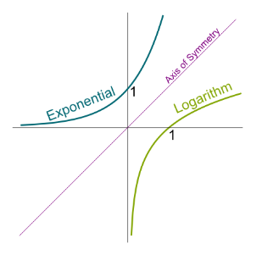
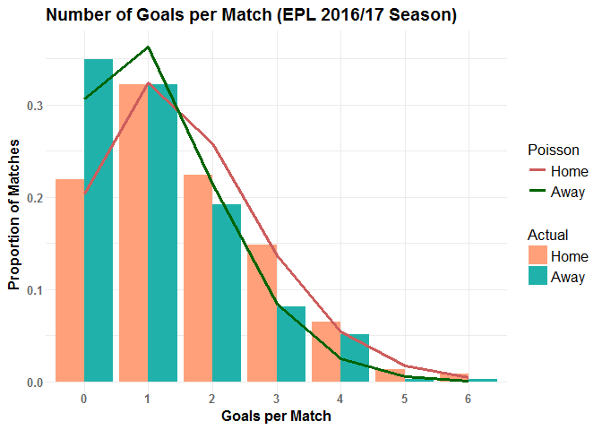
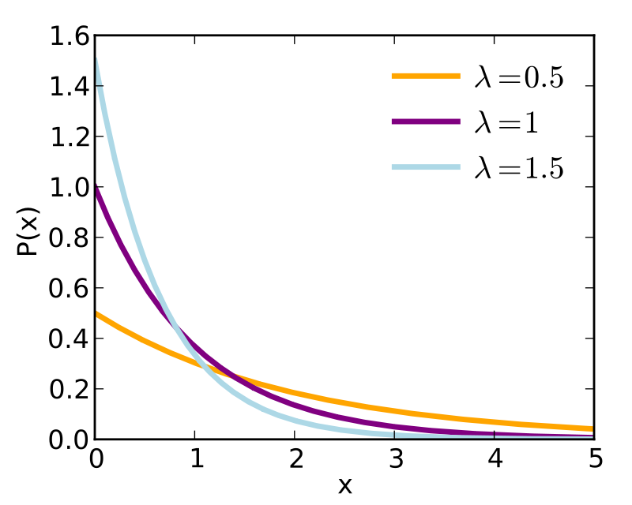

Poisson DISTRIBUTION
Rare events ($n≫1,p≪1)$
Number of events in finite and constant time interval $P\left(n\right)=e^{−μ}\frac{μ^{n}}{n!}$ Poisson distribution, $μ=λt$
Probability of having one event in dt: $dP=P_{(0,t)}=λdt$
Probability of 0 events: $P_{(0,t)}=e^{−λt}$
Probability density distribution $q\left(t\right)=\frac{dP}{dt}=λe^{−λt}$: negative exponential (more likely a little time separation than a long one)

Slide 14
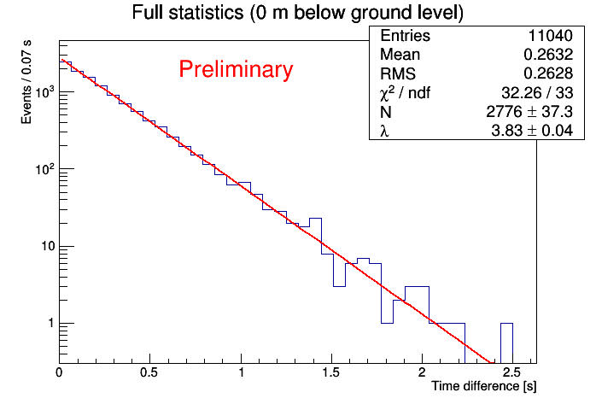
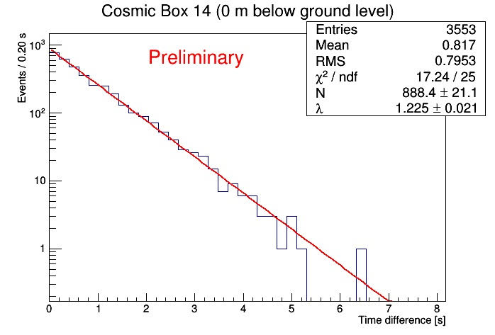
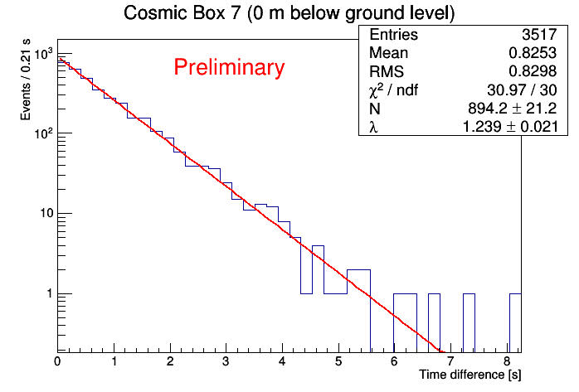
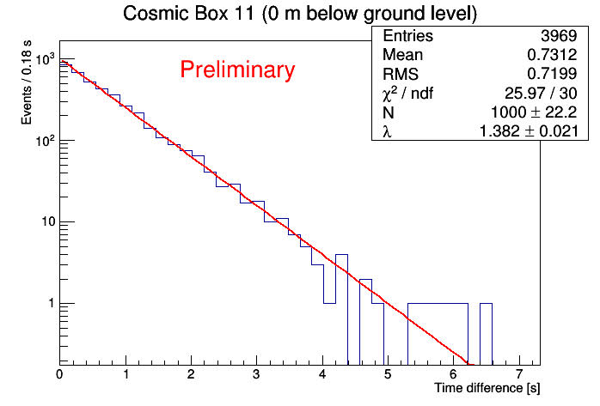
Distribution of time difference between two subsequent events
Outside the mine…
Acquisition time 2902s

Slide 15
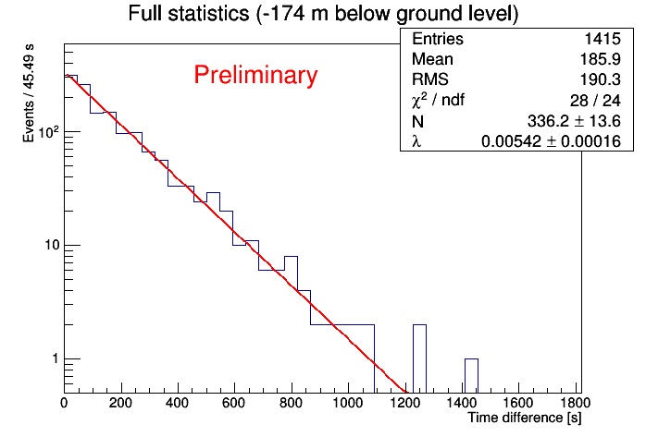
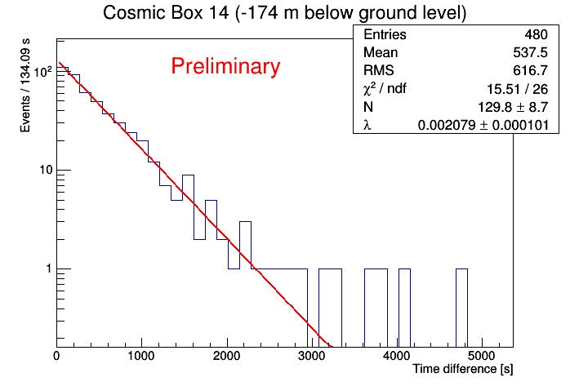
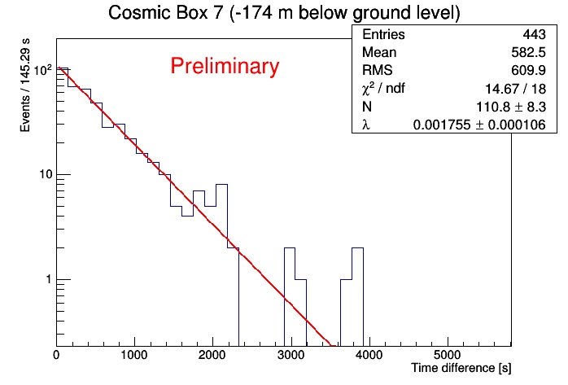
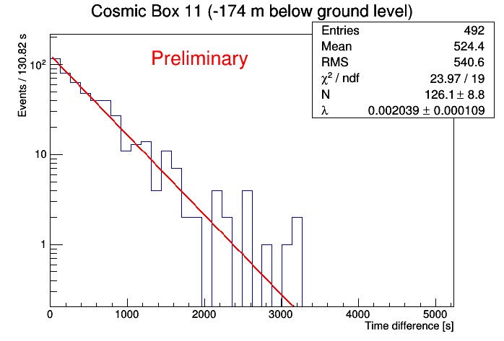
Distribution of time difference between two subsequent events
First level inside the mine.. Acquisition time 72hr=259200s

Slide 16
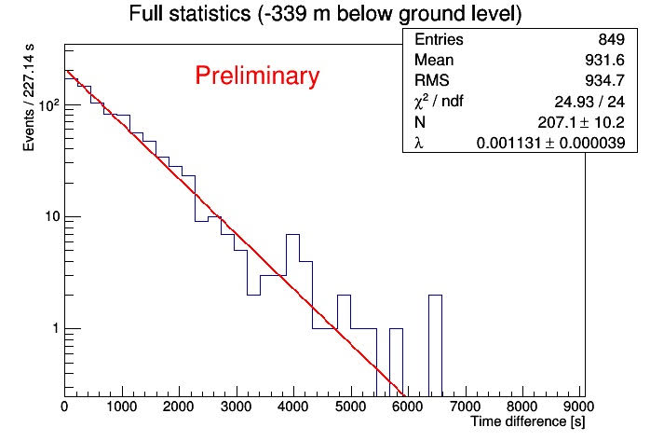
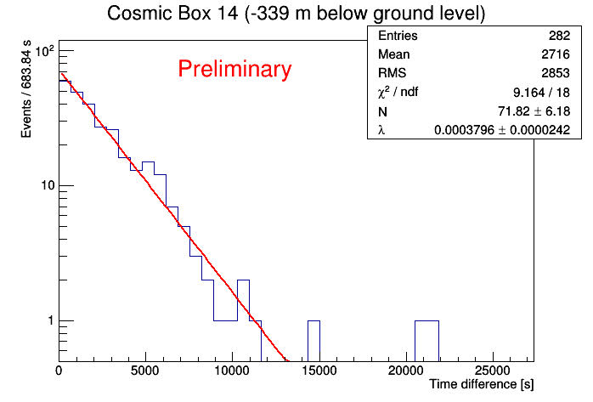
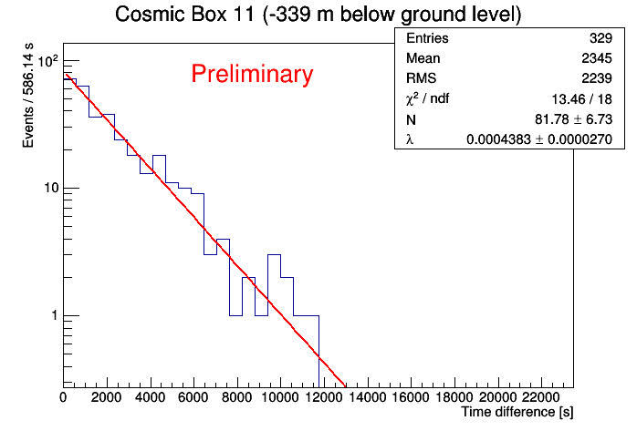
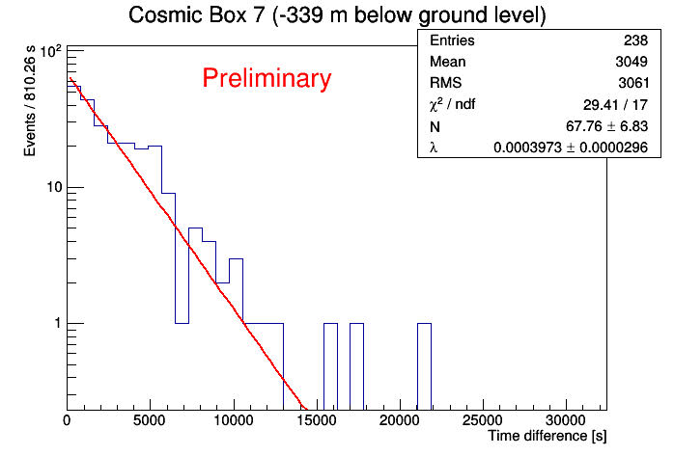
Distribution of time difference between two subsequent events
Second level inside the mine.. Acquisition time 9d=7.7̇̇̇̇̇̇∙10⁵s

Slide 17
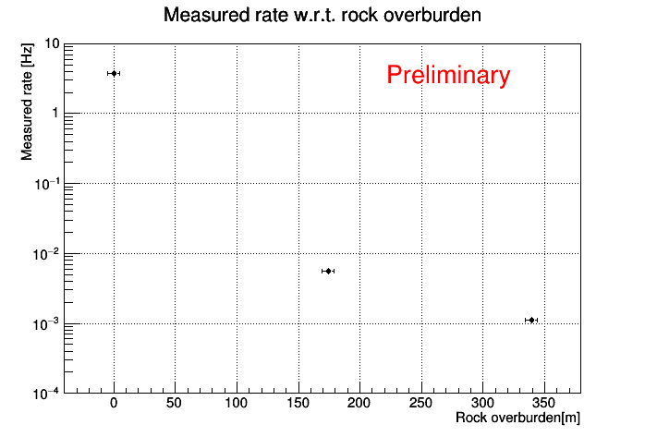
RESULTS: rate

Slide 18

Rate relative to the surface
R(surf) = (3.80±0.04) Hz
R(-174m) = (5.49±0.15)∙10⁻³ Hz
R(-339m)=(1.10±0.04)· 10⁻³ Hz
$\frac{R(−174)}{R(surf)}=(1.4\text{4}\text{±}$0.05) ∙10⁻³
$\frac{R(−339)}{R(surf)}=(2.\text{89}\text{±}\text{0,14}$) ∙10⁻⁴
Average Rock density in Nuraxi Figus?

Slide 19
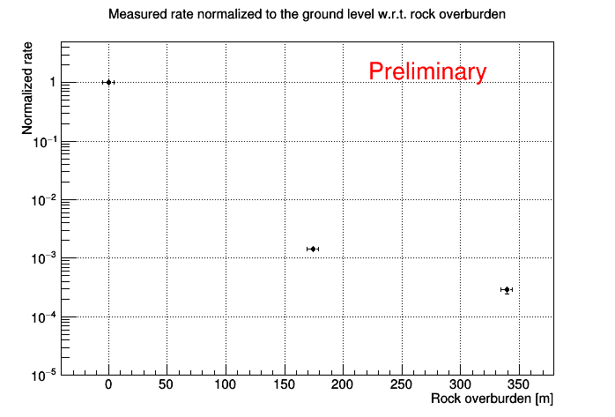
Normalised rate

Slide 20
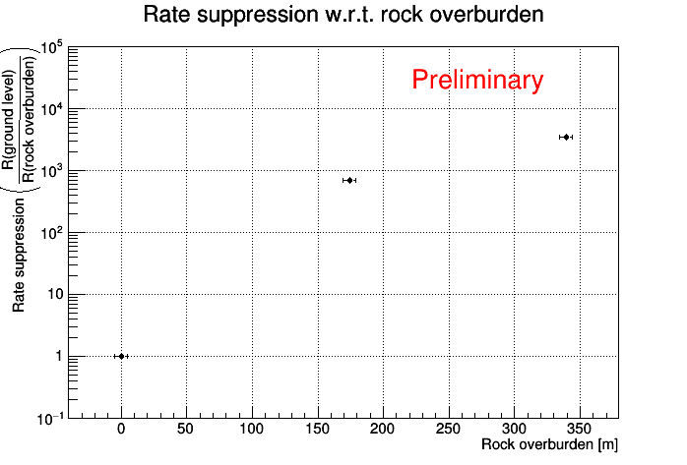
Rate suppression

Slide 21
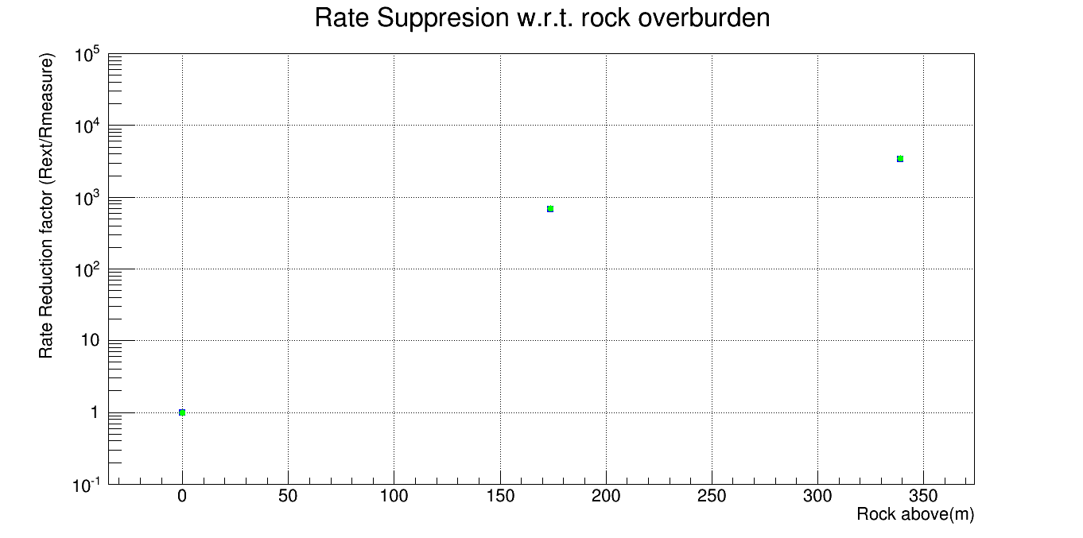
Rate suppression
Preliminary
Rate Suppression (R_{ground}/R_{(rock overburden)})
Cosmic Boxes
ASTRO
Rock Overburden (m)

Slide 22
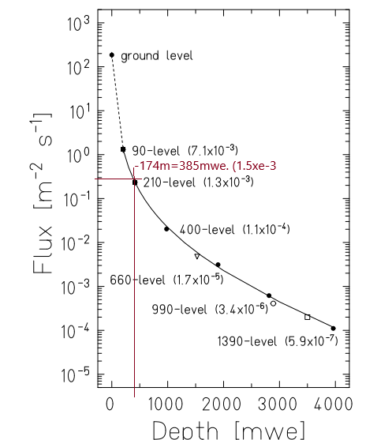
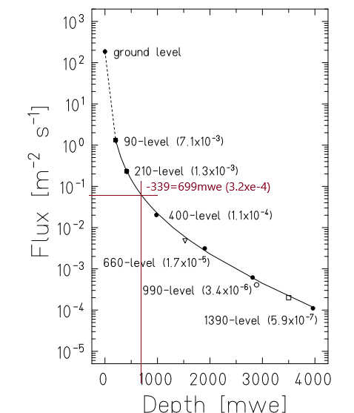


Comparison with Pyhäsalmi mine data
(1.5$\text{5±}$0.07) ∙10⁻³ cfr ($1.4\text{4}\text{±}$0.05) ∙10⁻³
(3.2$\text{±}$0.2) ∙10⁻⁴ cfr
($2.\text{89}\text{±}$0.14) ∙10⁻⁴

Slide 23
What else?
In progress: measurement @ mine’s deepest level
To be done:
Precise estimation of the efficiency and acceptance of the CB to measure the absolute flux.
Refining density profile and precise estimation of rock overburden over detector positioning

Slide 24
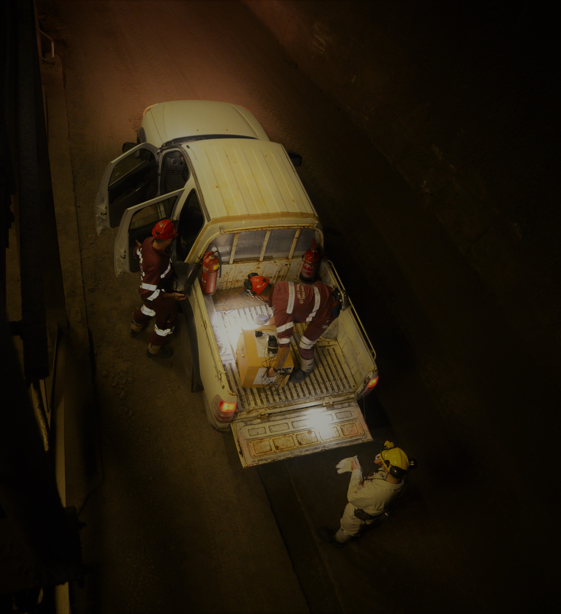
AcKNOWLEDGEments
Thanks to Nuraxi Figus mine’s personnel
Thanks to INFN Cagliari

Slide 25
Beyond

Slide 26
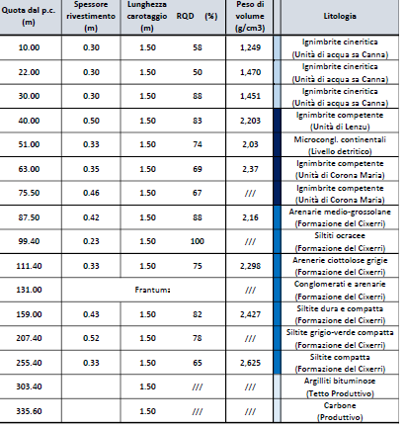
La Formazione del Cixerri è notoriamente una formazione di origine sedimentaria, in facies continentale, riferibile all’Oligocene che si sovrappone al, cosiddetto, “Lignifero” del Sulcis, la cui età è Eocenica. I sedimenti, sono costituiti in prevalenza da arenarie quarzose, grigio-violacee, biancoverdastre oppure rossastre, spesso conglomeratiche, a ciottoli di rocce paleozoiche o mesozoiche (soprattutto scisti neri, quarzo, porfidi e calcari del Giurese-Cretaceo). Le arenarie si alternano con marne ed argille siltose violacee o giallo-rossastre, spesso contenenti noduli concrezionari giallastri, ferruginosi, e ben stratificate

Slide 27
